Slide 1

DAY 2
Python Essentials
Fast Refresher, Then: Modularity, OOP, Decorators & Version Control
Faisal Goussous · August 2026

Slide 2
DAY 2
Welcome Back
YESTERDAY
SELECT, WHERE, GROUP BY, aggregates
CASE WHEN — flagging and bucketing
JOIN — and the mistakes that corrupt results
CTEs and self-joins
TODAY
1
Python refresher (quick!)
2
Modularity & classes
3
Inheritance & access control
4
Decorators
5
Version Control with Github
You already know Python — slides 1-21 are a fast recap. We'll move quickly.
6
First risk_utils code
PYTHON ESSENTIALS · DAY 2
2

Slide 3
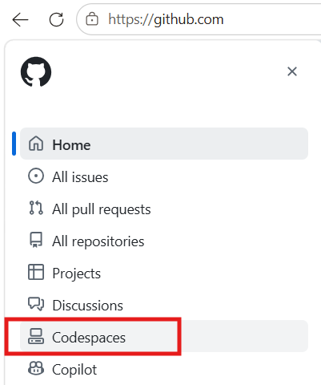
COURSE SETUP
Resume Your Codespace
Same repo, same Codespace as Day 1 — resume it rather than creating a new one.
Quick sanity check: confirm the transactions and accounts views are still there.
SELECT COUNT(*) FROM transactions;
SELECT COUNT(*) FROM accounts;
PYTHON ESSENTIALS · DAY 2
3

Slide 4
MOTIVATION
Why Python, Alongside SQL
SQL is great at querying and aggregating data that's already stored — set-based, declarative, fast.
Python is what you reach for once you need to automate something, reuse logic across many queries, or build a tool other people can run.
Today's goal: go beyond scripts — write modular, object-oriented, professional-grade Python as the foundation of a real package, risk_utils.
PYTHON ESSENTIALS · DAY 2
4

Slide 5
CONTEXT
A Brief History of Python
Created by Guido van Rossum, first released in 1991 — started as a hobby project over the 1989 Christmas holidays. Named after Monty Python's Flying Circus, not the snake.
Became popular because it reads almost like pseudocode — readability was a design goal from day one, not an afterthought.
“Batteries included” standard library, plus a massive open-source ecosystem, made it a default choice far beyond its scripting-language origins.
Today it's the dominant language for data science and AI (NumPy, pandas, scikit-learn, PyTorch) — and a big reason it's worth learning well, not just enough to get by.
PYTHON ESSENTIALS · DAY 2
5

Slide 6
PYTHON REFRESHER
Data Types
amount = 4520.75 # float
currency = "USD" # str
is_flagged = True # bool
txn_count = 12 # int
type(amount) # <class 'float'>
float("4520.75") # convert str -> float
PYTHON ESSENTIALS · DAY 2
6

Slide 7
PYTHON REFRESHER
Variables
large_txn_threshold = 10000
account_id = "834A31900"
is_laundering = False
PYTHON ESSENTIALS · DAY 2
7

Slide 8
PYTHON REFRESHER
Lists
amounts = [4520.75, 250.00, 18000.00, 999.99]
amounts[0] # 4520.75 (first item)
amounts[-1] # 999.99 (last item)
amounts[1:3] # [250.00, 18000.00] (slice)
PYTHON ESSENTIALS · DAY 2
8

Slide 9
PYTHON REFRESHER
List Methods
amounts.append(325.50) # add an item
amounts.sort() # sort in place
len(amounts) # how many items
18000.00 in amounts # membership check -> True
PYTHON ESSENTIALS · DAY 2
9

Slide 10
PYTHON REFRESHER
Dictionaries
txn = {
"from_account": "834A31900",
"to_account": "833FCBD00",
"amount_paid": 18000.00,
"payment_currency": "US Dollar",
"is_laundering": 1
}
PYTHON ESSENTIALS · DAY 2
10

Slide 11
PYTHON REFRESHER
Dictionary Methods
txn.keys() # dict_keys(['from_account', 'to_account', ...])
txn.values() # dict_values(['834A31900', '833FCBD00', ...])
txn.items() # key-value pairs, for looping
txn.get("amount_paid") # 18000.00
txn.get("missing_key") # None -- no error
PYTHON ESSENTIALS · DAY 2
11

Slide 12
PYTHON REFRESHER
Importing Libraries
import math
from datetime import datetime
import pandas as pd # alias -- common convention
math.round(4520.75)
datetime.now()
PYTHON ESSENTIALS · DAY 2
12

Slide 13
CHALLENGE
Lists & Dicts — Exercise 1
WRITE
sample_txns = [
{"account": "A1", "amount_paid": 4500, "is_laundering": 0},
{"account": "A2", "amount_paid": 18000, "is_laundering": 1},
{"account": "A3", "amount_paid": 250, "is_laundering": 0},
]
print(sample_txns[1]["amount_paid"])
CHALLENGE
Add a fourth transaction to the list, then print its account and amount_paid.
PYTHON ESSENTIALS · DAY 2
13

Slide 14
CHALLENGE
Lists & Dicts — Exercise 2
WRITE
amounts = [t["amount_paid"] for t in sample_txns]
print(amounts)
print(max(amounts))
CHALLENGE
Without using list-comprehension syntax, write the same amounts list using a for loop instead.
PYTHON ESSENTIALS · DAY 2
14

Slide 15
PYTHON REFRESHER
Functions
def is_large(amount, threshold):
return amount > threshold
is_large(18000, 10000) # True
is_large(250, 10000) # False
PYTHON ESSENTIALS · DAY 2
15

Slide 16
PYTHON REFRESHER
Functions (Continued)
def is_large(amount, threshold=10000): # default argument
return amount > threshold
is_large(18000) # uses the default threshold -> True
def flag(amount, threshold=10000):
return amount, amount > threshold # return multiple values
amt, flagged = flag(18000)
PYTHON ESSENTIALS · DAY 2
16

Slide 17
PYTHON REFRESHER
Higher-Order Functions
A higher-order function takes another function as an argument, or returns one. Functions are just values in Python.
def apply_to_all(items, func):
return [func(i) for i in items]
def double(x):
return x * 2
apply_to_all([1, 2, 3], double) # [2, 4, 6]
list(map(double, [1, 2, 3])) # built-ins are HOFs too
list(filter(lambda x: x > 1, [1, 2, 3]))
Keep this in mind — decorators, later today, are built entirely on this idea.
PYTHON ESSENTIALS · DAY 2
17

Slide 18
PYTHON REFRESHER
Loops
for amount in amounts:
print(amount)
for i in range(5):
print(i) # 0, 1, 2, 3, 4
PYTHON ESSENTIALS · DAY 2
18

Slide 19
PYTHON REFRESHER
Loops (Continued)
i = 0
while i < len(amounts):
if amounts[i] > 10000:
break # stop the loop early
i += 1
for idx, amount in enumerate(amounts):
print(idx, amount) # position + value together
PYTHON ESSENTIALS · DAY 2
19

Slide 20
PRACTICAL 1
Validation Functions — Exercise 1
WRITE
def check_positive_amount(amount):
if amount <= 0:
raise ValueError(f"amount_paid must be positive, got {amount}")
return True
def check_required_fields(txn, required=("Account", "Amount_Paid", "Timestamp")):
########################
# Complete the function
########################
return True
CHALLENGE
Complete check_required_fields so it raises a ValueError listing any of the required fields missing from txn.
PYTHON ESSENTIALS · DAY 2
20

Slide 21
PRACTICAL 1
Validation Functions — Exercise 2
CHALLENGE
Run validate_transaction on myTransaction below, then break it on purpose — remove a key or make Amount_Paid negative — and confirm the right error fires.
Hint: validate_transaction() calls check_positive_amount() then check_required_fields() in order — trigger each failure separately to see both error messages.
PYTHON ESSENTIALS · DAY 2
21

Slide 22
CODE MODULARITY
What Is Modularity?
Breaking a program into small, focused, independent pieces — functions, classes, modules — that each do one job well and can be combined.
Think Lego, not a single molded block: standardized pieces you can recombine, swap, and reuse, instead of one giant piece you have to rebuild every time something changes.
Payoff: easier to test (each piece in isolation), easier to reuse, easier to reason about, and easier to change without breaking everything else.
PYTHON ESSENTIALS · DAY 2
22

Slide 23
CODE MODULARITY
Code Modularity — Bad Example
# everything inline, repeated, hard to reuse or test
total = 0
for t in sample_txns:
if t["amount_paid"] > 10000:
total = total + t["amount_paid"]
print(total)
# ...50 lines later, the same threshold check, copy-pasted again
big_ones = []
for t in sample_txns:
if t["amount_paid"] > 10000:
big_ones.append(t)
PYTHON ESSENTIALS · DAY 2
23

Slide 24
CODE MODULARITY
Code Modularity — Good Example
def is_large(amount, threshold=10000):
return amount > threshold
def total_large(transactions, threshold=10000):
return sum(t["amount_paid"] for t in transactions if is_large(t["amount_paid"], threshold))
def filter_large(transactions, threshold=10000):
return [t for t in transactions if is_large(t["amount_paid"], threshold)]
Same logic, written once (is_large) and reused everywhere it's needed — the threshold only has to change in one place.
PYTHON ESSENTIALS · DAY 2
24

Slide 25
PRACTICAL 2
Refactoring Practice
WRITE (MESSY VERSION)
txn1 = {'Receiving_Currency': 'US Dollar', 'Amount_Received': 9999}
txn2 = {'Receiving_Currency': 'Rupee', 'Amount_Received': 10**5}
if txn1['Receiving_Currency'] == 'US Dollar':
if 9900 <= txn1['Amount_Received'] < 10000:
print('Possible Fraud!')
if txn1['Receiving_Currency'] == 'Rupee':
if 952058.50*.90 <= txn1['Amount_Received'] < 952058.50:
print('Possible Fraud!')
CHALLENGE
Split this into two files — main.py (defines txn1/txn2, calls fraud_checks) and fraud_checks.py (one check_amount(amount, currency) function, using the to_usd_factors dict).
PYTHON ESSENTIALS · DAY 2
25

Slide 26
OBJECT-ORIENTED PROGRAMMING
Why Classes?
A dict stores a transaction's data — but has no behavior of its own.
Classes are a natural way to describe the real world: most real things have both properties (data) and behaviors (actions) bundled together.
A Car has a color and a fuel level, and it can drive and brake. A BankAccount has a balance and owner, and it can deposit and withdraw. A Customer has a name and risk score, and can be flagged as high-risk.
A class lets our code mirror that same shape — data and behavior in one place. This is the first real building block of risk_utils.
PYTHON ESSENTIALS · DAY 2
26

Slide 27
OBJECT-ORIENTED PROGRAMMING
Anatomy of a Class
class Transaction:
def __init__(self, account_number, amount, currency, is_laundering):
self.account_number = account_number
self.amount = amount
self.currency = currency
self.is_laundering = is_laundering
txn = Transaction("834A31900", 18000, "US Dollar", 1)
txn.amount # 18000
__init__ runs when a new object is created; self refers to the specific object being built.
PYTHON ESSENTIALS · DAY 2
27

Slide 28
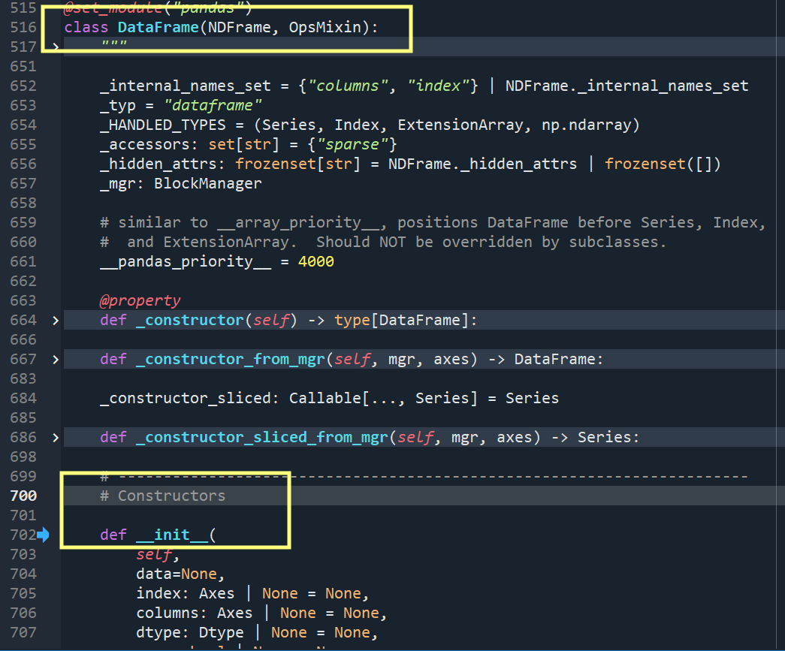
OBJECT-ORIENTED PROGRAMMING
Professional Example
Example from the Pandas package
PYTHON ESSENTIALS · DAY 2
27

Slide 29
OBJECT-ORIENTED PROGRAMMING
Adding Methods
class Transaction:
def __init__(self, account_number, amount, currency, is_laundering):
self.account_number = account_number
self.amount = amount
self.currency = currency
self.is_laundering = is_laundering
def is_large(self, threshold=10000):
return self.amount > threshold
txn.is_large() # True
PYTHON ESSENTIALS · DAY 2
28

Slide 30
OBJECT-ORIENTED PROGRAMMING
Worked Example: The Transaction Class
class Transaction:
def __init__(self, account_number, account_name, amount, currency, is_laundering, timestamp=None):
self.account_number = account_number
self.account_name = account_name
self.amount = amount
self.currency = currency
self.is_laundering = bool(is_laundering)
self.timestamp = timestamp or datetime.now()
def summary(self):
flag = "LAUNDERING" if self.is_laundering else "Not Laundering"
return f"[{flag}] account={self.account_number} amount={self.amount}"
PYTHON ESSENTIALS · DAY 2
29

Slide 31
PRACTICAL 3
Transaction Class — Exercise 1
CHALLENGE
Add a method, is_large(), that returns True if the amount (converted to USD) is above $10,000.
PYTHON ESSENTIALS · DAY 2
30

Slide 32
PRACTICAL 3
Transaction Class — Exercise 2
CHALLENGE
Add a method, is_reportable(), that returns True if the Transaction is both large and flagged as laundering.
This mirrors the CASE WHEN + AND logic from Day 1's SQL — same idea, expressed as a method.
PYTHON ESSENTIALS · DAY 2
31

Slide 33
OBJECT-ORIENTED PROGRAMMING
Inheritance: Extending Transaction
Inheritance lets a new class reuse and extend an existing one, instead of copying its code — super().__init__() must forward every field it receives.
class BitcoinTransaction(Transaction):
def __init__(self, account_number, amount,
currency, is_laundering):
super().__init__(account_number, amount,
currency, is_laundering)
if self.currency.lower() != "bitcoin":
raise ValueError("Not a Bitcoin transaction!")
def is_reportable(self):
return True # always reportable
PYTHON ESSENTIALS · DAY 2
32

Slide 34
PRACTICAL 4
Simplify BitcoinTransaction
CHALLENGE
Right now BitcoinTransaction duplicates every line of Transaction. Rewrite it to inherit from Transaction and call super().__init__() instead — is_reportable() should still always return True.
PYTHON ESSENTIALS · DAY 2
33

Slide 35
OBJECT-ORIENTED PROGRAMMING
Inheritance: The Diamond Problem
What happens when a class inherits from two classes that both inherit from a common base — which version of a shared method wins?
class A:
def greet(self): return "A"
class B(A):
def greet(self): return "B"
class C(A):
def greet(self): return "C"
class D(B, C):
pass
D().greet() # "B" -- Python's MRO: D -> B -> C -> A
D.__mro__ # inspect the resolution order directly
Python resolves this with a defined Method Resolution Order (MRO / C3 linearization) — deterministic, but easy to get lost in. It's a big reason composition is often preferred over deep multiple inheritance.
PYTHON ESSENTIALS · DAY 2
34

Slide 36
OBJECT-ORIENTED PROGRAMMING
Access Control in Python
Unlike Java or C++, Python has no enforced private or protected keywords — access control is convention, not compiler-enforced.
A single leading underscore (_protected) is just a convention signaling “internal use” — nothing stops external access.
A double leading underscore (__private) triggers name mangling: a compile-time mechanism where Python automatically renames the variable to include the class name, in the format _ClassName__variable.
class Transaction:
def __init__(self, amount):
self.amount = amount # public
self._threshold = 10000 # protected -- convention only
self.__internal_id = "A1" # private -- name-mangled
txn._threshold # works, but "you shouldn't"
txn._Transaction__internal_id # the mangled name -- works, but not true privacy
The underlying philosophy: “we're all consenting adults here.” Python trusts developers and documentation over walls the compiler enforces.
PYTHON ESSENTIALS · DAY 2
35

Slide 37
OBJECT-ORIENTED PROGRAMMING
Composition
Composition builds a class out of other objects — a "has-a" relationship, instead of inheritance's "is-a." Transaction will "have" a CurrencyConverter, not "be" one.
class CurrencyConverter:
def to_usd(self, amount, currency):
return amount * self.to_usd_factors[currency]
class Transaction:
def __init__(self, account_number, amount, currency, is_laundering):
self.account_number = account_number
self.amount = amount
self.currency = currency
self._converter = CurrencyConverter() # "has-a" a converter
PYTHON ESSENTIALS · DAY 2
36

Slide 38
PRACTICAL 5
Build CurrencyConverter
CHALLENGE
1) Write a CurrencyConverter class with a to_usd(amount, base_currency) method. 2) Give Transaction a CurrencyConverter instance in __init__ — composition. 3) Finish is_large() using it.
Question: what access control should the CurrencyConverter attribute have inside Transaction?
PYTHON ESSENTIALS · DAY 2
37

Slide 39
CODE REUSE
Decorators: Why They Matter
Code Reuse — apply the same logic (like logging or timing) to dozens of different functions with one line of code.
Separation of Concerns — keep your core business logic clean by separating it from administrative tasks like security or caching.
Pythonic Standard — used everywhere in professional Python frameworks like Flask, FastAPI, and Django.
PYTHON ESSENTIALS · DAY 2
38

Slide 40
CODE REUSE
Decorators: How They Work
A decorator is just a higher-order function (slide 17): it takes a function in and returns a new function out.
@decorator_name written above a function is shorthand — it's exactly the same as func = decorator_name(func).
Inside, the decorator defines an inner wrapper() that calls the original function; wrapper is what actually runs when you call the decorated function.
*args, **kwargs let wrapper() accept whatever arguments the original function takes, without needing to know them ahead of time.
def my_decorator(func):
def wrapper(*args, **kwargs):
print("Before the function runs")
result = func(*args, **kwargs)
print("After the function runs")
return result
return wrapper
@my_decorator
def say_hello(name):
print(f"Hello, {name}!")
say_hello("Faisal")
PYTHON ESSENTIALS · DAY 2
39

Slide 41
CODE REUSE
Decorators: Example 1 — Timing
A TIMING DECORATOR
import time
def timer(func):
def wrapper(*args, **kwargs):
start = time.time()
result = func(*args, **kwargs)
print(f"{func.__name__} took {time.time()-start:.4f}s")
return result
return wrapper
@timer
def flag_high_risk(transactions, threshold=10000):
return [t for t in transactions if t["amount_paid"] > threshold]
@timer is shorthand for: flag_high_risk = timer(flag_high_risk) — a decorator is just a higher-order function with nicer syntax.
PYTHON ESSENTIALS · DAY 2
40

Slide 42
CODE REUSE
Decorators: Example 2 — Logging
A LOGGING DECORATOR
def log_call(func):
def wrapper(*args, **kwargs):
print(f"Calling {func.__name__} with {args}")
return func(*args, **kwargs)
return wrapper
@log_call
def is_large(amount, threshold=10000):
return amount > threshold
is_large(18000)
# prints: Calling is_large with (18000,)
# then returns: True
Same shape as the timing decorator — one wrapper pattern, reused for a completely different concern.
PYTHON ESSENTIALS · DAY 2
41

Slide 43
PRACTICAL 6
Decorate Transaction's Methods
CHALLENGE
Finish timer() in decorators.py — call the wrapped function, capture the elapsed time, then print it. Then apply @log_call to is_large() and @timer to is_reportable().
PYTHON ESSENTIALS · DAY 2
42

Slide 44
VERSION CONTROL WITH GITHUB
PYTHON ESSENTIALS · DAY 2
43

Slide 45
VERSION CONTROL
Why Not Just Use a Shared Drive?
No change tracking — if a shared file breaks, there's no history showing what changed, when, or who did it.
One save can silently overwrite someone else's — two people editing the same file at once means whoever saves last wins, with no warning.
A deleted file is just gone — no easy way to get last week's working version back.
Naming becomes the only “version control” — risk_utils_final.py, risk_utils_final_v2.py, risk_utils_final_ACTUALLY_FINAL.py — and nobody's sure which one is really running.
Git solves all four of these — that's what the rest of this section covers.
PYTHON ESSENTIALS · DAY 2
44

Slide 46
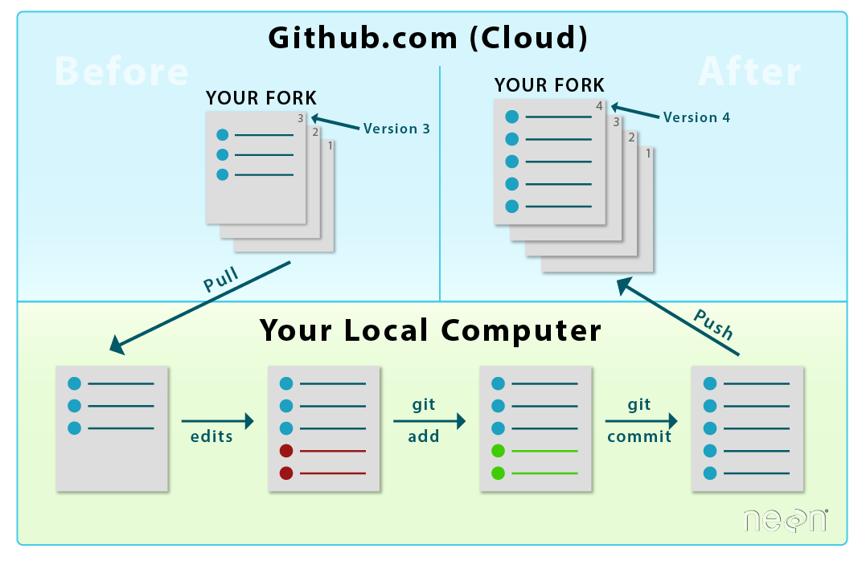
GITHUB BASICS
Commit vs. Push vs. Pull
Same three words, three different directions — here's where each one actually moves your code.
https://www.neonscience.org/
PYTHON ESSENTIALS · DAY 2
45

Slide 47
GITHUB BASICS
Cloning
Cloning downloads a full copy of a repo — code, history, branches — onto your machine, or in our case, your Codespace.
Launching your Codespace already did this for you: it cloned the course template repo before your first line of code ran.
git clone <url> is the manual version of what “Create Codespace” just did automatically.
PYTHON ESSENTIALS · DAY 2
46

Slide 48
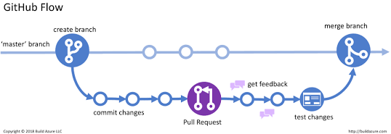
GITHUB BASICS
Branching
A branch is an independent line of work — changes on it don't touch main until you merge them.
git checkout -b your-branch-name creates a new branch and switches to it in one step.
Working on your own branch means your teammates' pushes and pulls can't collide with work you haven't committed yet.
PYTHON ESSENTIALS · DAY 2
47

Slide 49
GITHUB BASICS
Staging & Committing
git add students/FirstName_LastName
# stages the change - tells git "include this in the next commit"
git commit -m "Add FirstName_LastName folder"
# saves a checkpoint, with a message, to your LOCAL history only
# nothing has left your machine yet - commit is not the same as
# save-to-the-cloud, it's save-a-checkpoint-i-can-return-to
PYTHON ESSENTIALS · DAY 2
48

Slide 50
GITHUB BASICS
Pushing & Pulling
git push origin your-branch
# uploads your local commits to GitHub - now others can see them
git pull origin your-branch
# downloads commits from GitHub that you don't have locally yet
# rule of thumb: push shares YOUR work, pull collects EVERYONE else's
PYTHON ESSENTIALS · DAY 2
49

Slide 51
GITHUB BASICS
When Something Goes Wrong
! [rejected] main -> main (fetch first)
# someone else pushed since you last pulled - pull, then push again
git pull origin main
fatal: not a git repository
# you're not inside the project folder yet
cd risk_utils
You are in 'detached HEAD' state
# you checked out a commit instead of a branch
git checkout main
PYTHON ESSENTIALS · DAY 2
50

Slide 52
PRACTICAL 1
Create, Commit & Push
WRITE
Bottom-left branch icon -> Create new branch -> firstname-lastname
Explorer: new folder "students/FirstName_LastName", new file ".gitkeep" inside it
Source Control panel (Ctrl+Shift+G): stage with +, message "Add FirstName_LastName folder"
Click Commit, then Sync Changes (this pushes your branch to GitHub)
# prefer the terminal? the same add / commit / push commands from
# the last two slides work here too - just cd into the repo first
CHALLENGE
Check GitHub.com — confirm your branch and folder (with .gitkeep) show up before moving on.
PYTHON ESSENTIALS · DAY 2
51

Slide 53
PRACTICAL 2
Pull Everyone Else's Folders
WRITE
Bottom-left branch icon -> switch to "main"
Source Control panel -> "..." menu -> Pull (or click the sync icon)
Explorer: open the students/ folder
# terminal equivalent:
git checkout main && git pull origin main
CHALLENGE
Count the folders in students/ — does it match the number of people in the room?
PYTHON ESSENTIALS · DAY 2
52

Slide 54
THE PACKAGE
Introducing risk_utils
Everything built today — is_large, is_reportable, Transaction, BitcoinTransaction, the @timer and @log_call decorators — is the start of a real, reusable Python package.
Tomorrow: organize it properly, version it, and publish it so future course cohorts can import risk_utils instead of rewriting this from scratch.
PYTHON ESSENTIALS · DAY 2
53

Slide 55
THE PACKAGE
Planning the Structure
risk_utils/
models.py — Transaction and BitcoinTransaction
decorators.py — reusable decorators, e.g. @timer, @log_call
__init__.py
We'll add validation.py, fraud.py, and io.py on Day 3 — today, focus on getting the logic right.
PYTHON ESSENTIALS · DAY 2
54

Slide 56
CHALLENGE
Save Today's Work
WRITE
# models.py # decorators.py
class Transaction: def timer(func):
... ...
class BitcoinTransaction: def log_call(func):
... ...
CHALLENGE
Move your classes and decorators into the right module files from the structure above. Commit both.
PYTHON ESSENTIALS · DAY 2
55

Slide 57
DAY 2 RECAP
What We Covered
Fast Python refresher — plus a look at higher-order functions
Modularity — from single-purpose functions to classes as a second tool
Classes & objects — building Transaction as a real-world description
Inheritance, the diamond problem, and Python's access-control philosophy
Decorators — code reuse and separation of concerns, industry-standard
Version Control — Github, repository actions: commit, push, pull, branch
Next up — Day 3: organizing, versioning, and publishing risk_utils + advanced topics if time permits
Thank you — Questions?

